Slide 1
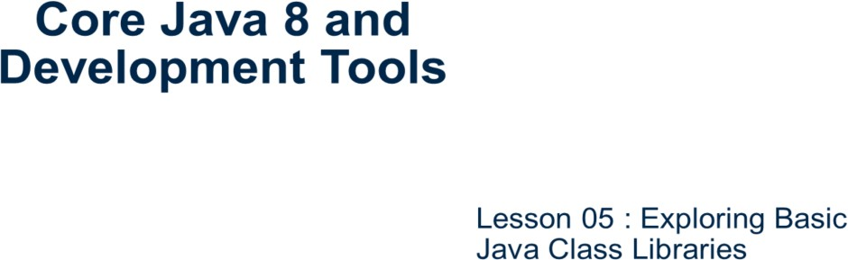
Core Java 8 and Development Tools
Exploring Basic Java Class Libraries

Slide 2
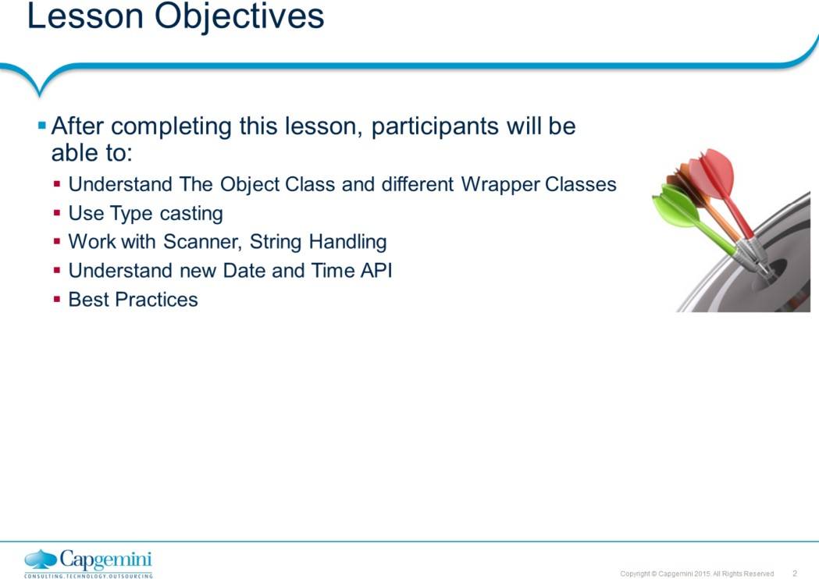
Core Java 8 and Development Tools
Exploring Basic Java Class Libraries
Lesson Objectives:
This lesson introduces to the fundamental Java API that is used in almost every type of Java applications.
Lesson 5: Exploring Java Basics 5.1: The Object Class 5.2: Wrapper Classes
: Type casting
: Using Scanner Class 5.5: The System Class 5.6: String Handling
5.7: Date and Time API 5.7: Best Practices

Slide 3
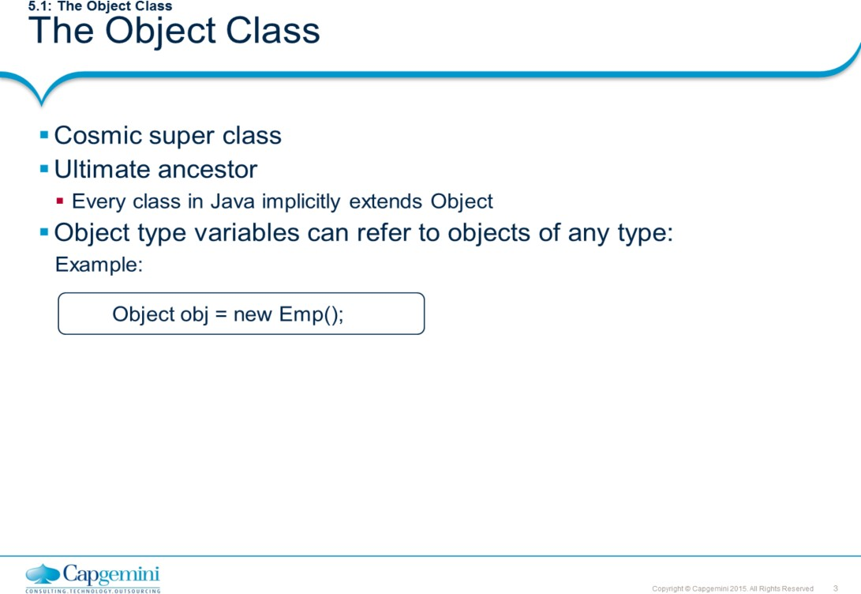
Core Java 8 and Development Tools
Exploring Basic Java Class Libraries
The Object super class is a cosmic super class. Every class in Java extends Object class. It means a reference of object type can refer to an object of any other class. In addition, an array can be referenced by an object reference.
Example:
Object Obj1 = new Box(…….);

Slide 4
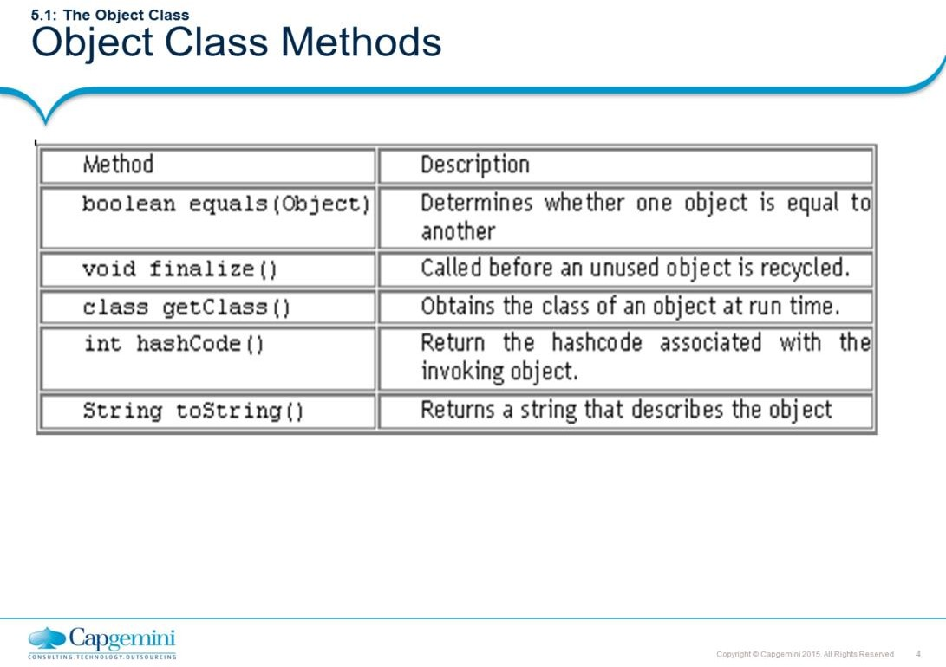
Core Java 8 and Development Tools
Exploring Basic Java Class Libraries
The table above shows some of the methods of the Object superclass. Please refer to Java docs for the entire list.

Slide 5
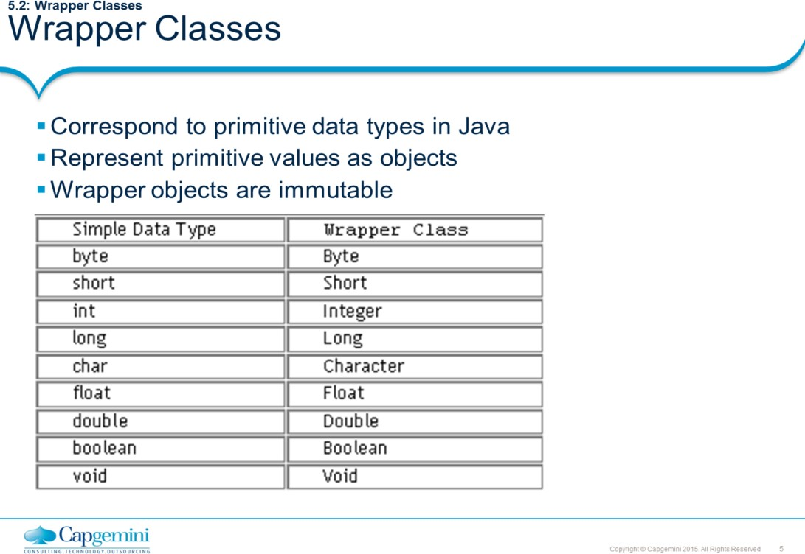
Core Java 8 and Development Tools
Exploring Basic Java Class Libraries
Wrapper classes correspond to the primitive data types in the Java language. These classes represent the primitive values as objects. Wrapper objects are immutable. This means that once a wrapper object has a value assigned to it, that value cannot be changed.
Java uses simple or primitive data types, such as int, char and Boolean etc. These data types are not part of the object hierarchy. They are passed by value to methods and cannot be directly passed by reference. However, at times there is a need to create an object representation of these simple data types. Java provides classes that correspond to each of these simple types. These classes encapsulate, or wrap, the simple data type within a class. Thus, they are commonly referred to as wrapper classes. The abstract class Number defines a superclass that is implemented by all numeric wrapper classes.

Slide 6
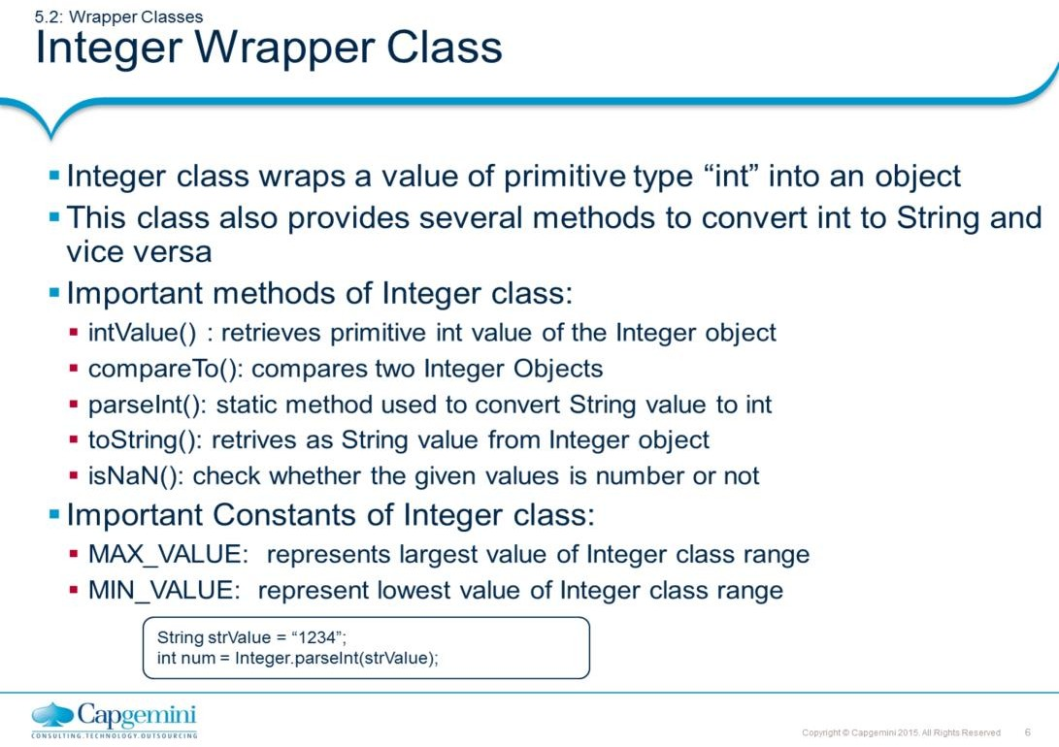
Core Java 8 and Development Tools
Exploring Basic Java Class Libraries
Above slide represents methods and constants provided by Integer wrapper class. Other wrapper classes too have similar kind of method and constant structure. The method names varies according to the wrapper class name. For example, intValue() method is anonymous to longValue() of Long wrapper class.

Slide 7
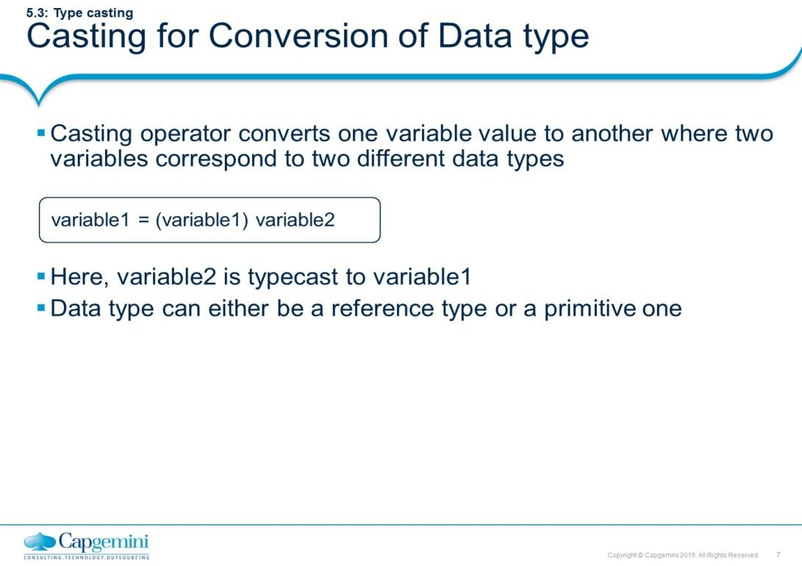
Core Java 8 and Development Tools
Exploring Basic Java Class Libraries

Slide 8
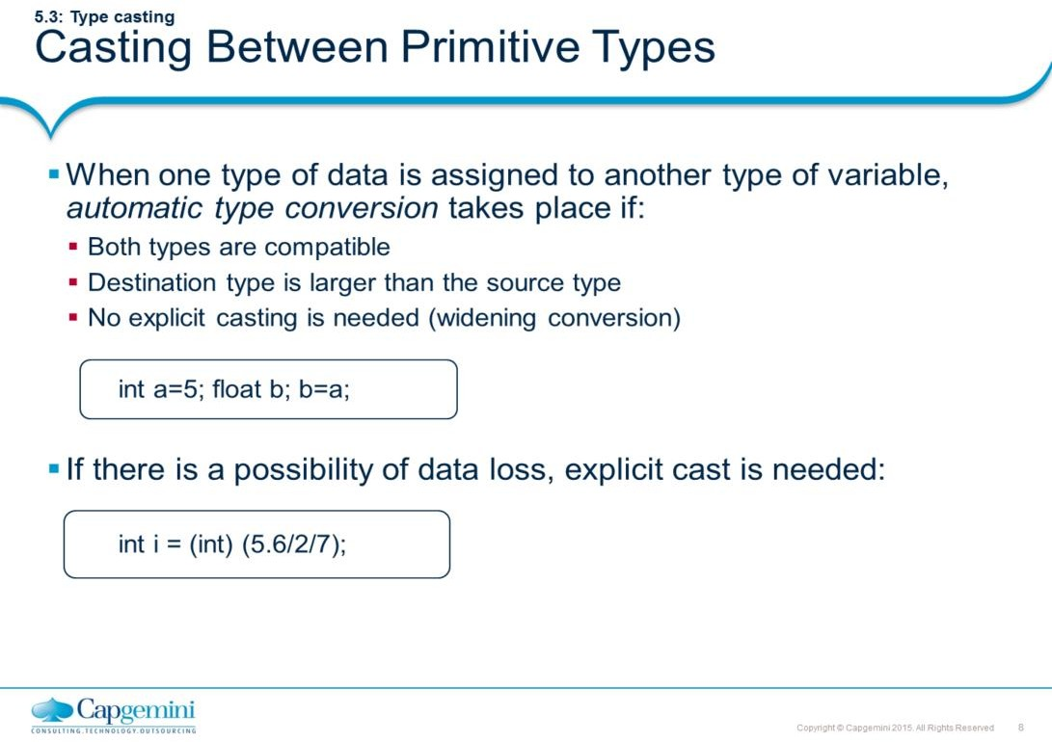
Core Java 8 and Development Tools
Exploring Basic Java Class Libraries
When one type of data is assigned to another type of variable, an automatic type conversion will take place if the following two conditions are met:
The two types are compatible.
The destination type is larger than the source type.
In this case, a widening conversion takes place. For example, the int type is always large
enough to hold all valid byte values, so no explicit cast statement is required.
To widen conversions, numeric types, including integer and floating-point types, are compatible with each other. However, numeric types are not compatible with char or boolean. Also, char and boolean are not compatible with each other.
As mentioned earlier, Java also performs an automatic type conversion when storing a literal integer constant into variables of type byte, short, or long.
Casting Incompatible Types
Automatic type conversions may not fulfill all needs though. For example, assigning an int value to a byte variable. This conversion will not be performed automatically, because a byte is smaller than an int. This is called a narrowing conversion, since you are explicitly making the value narrower so that it will fit into the target type. This is done using a cast - an explicit type conversion. It has this general form: (target-type) value Here, target-type specifies the desired type to convert the specified value to. For example, the following fragment casts an int to a byte:
int i = 125; byte b; b = (byte) i;

Slide 9
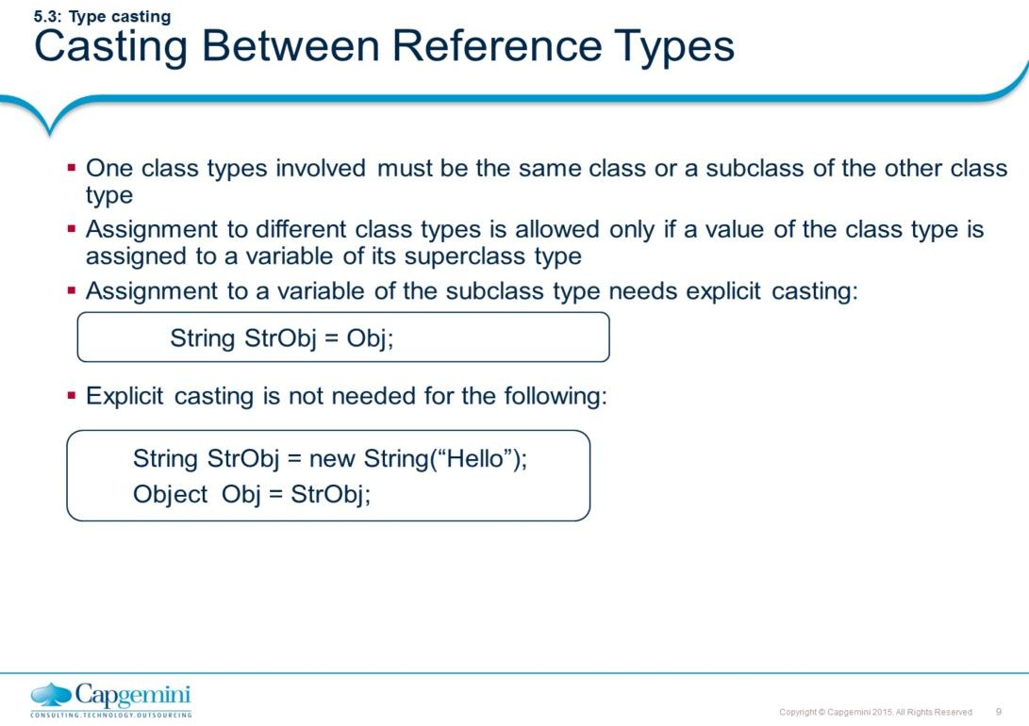
Core Java 8 and Development Tools
Exploring Basic Java Class Libraries
The first rule of casting between reference types is that one of the class types involved must be the same class as, or a subclass of, the other class type. Assignment to different class type is allowed only if a value of the class type is assigned to a variable of its superclass type. Assignment to a variable of the subclass type needs explicit casting.
Object Obj = new Object ( ); String StrObj = Obj;
/* The second statement of the above code is not a legitimate one, because class String is a subclass of class object. So, an explicit casting is needed. This is called as downcasting
*/
String StrObj = (String) Obj;
//The reverse statement will not require casting. It is upcasting String StrObj = new String(“Hello”);
Object Obj = StrObj;
Rule number one in casting is that you cannot cast a primitive type to a reference type, nor can you cast the other way around. If a casting violation is detected at runtime, the exception ClassCastException is thrown.

Slide 10
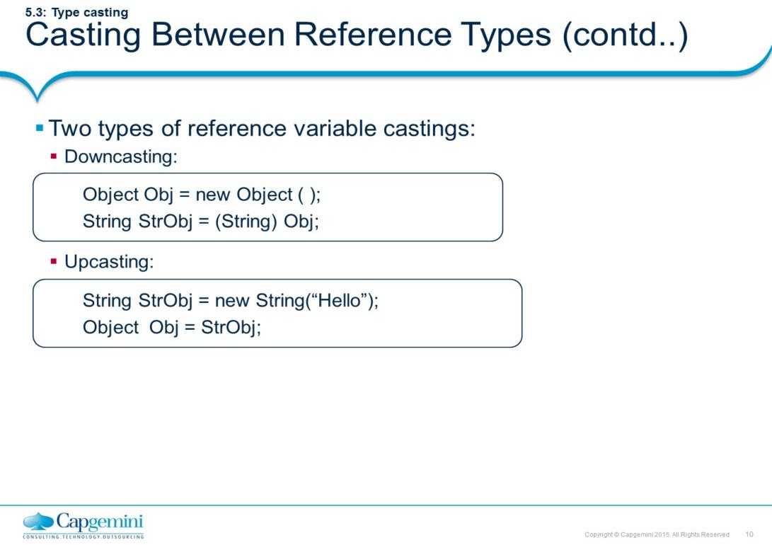
Core Java 8 and Development Tools
Exploring Basic Java Class Libraries

Slide 11
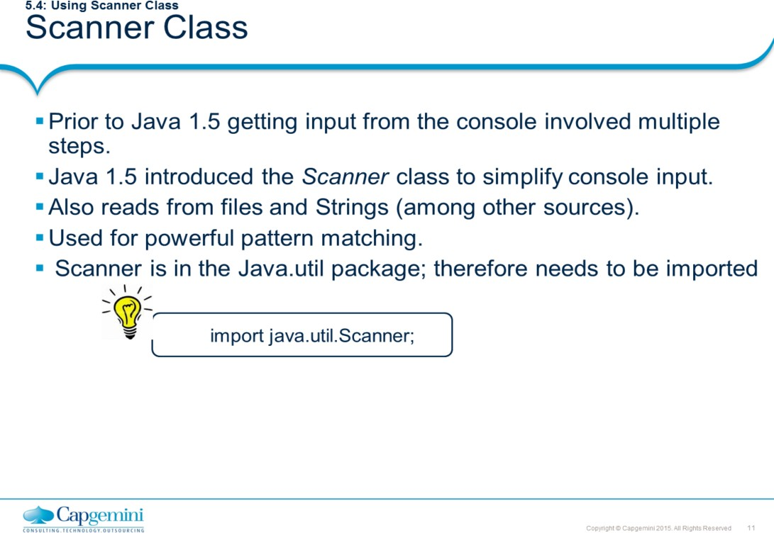
Core Java 8 and Development Tools
Exploring Basic Java Class Libraries

Slide 12
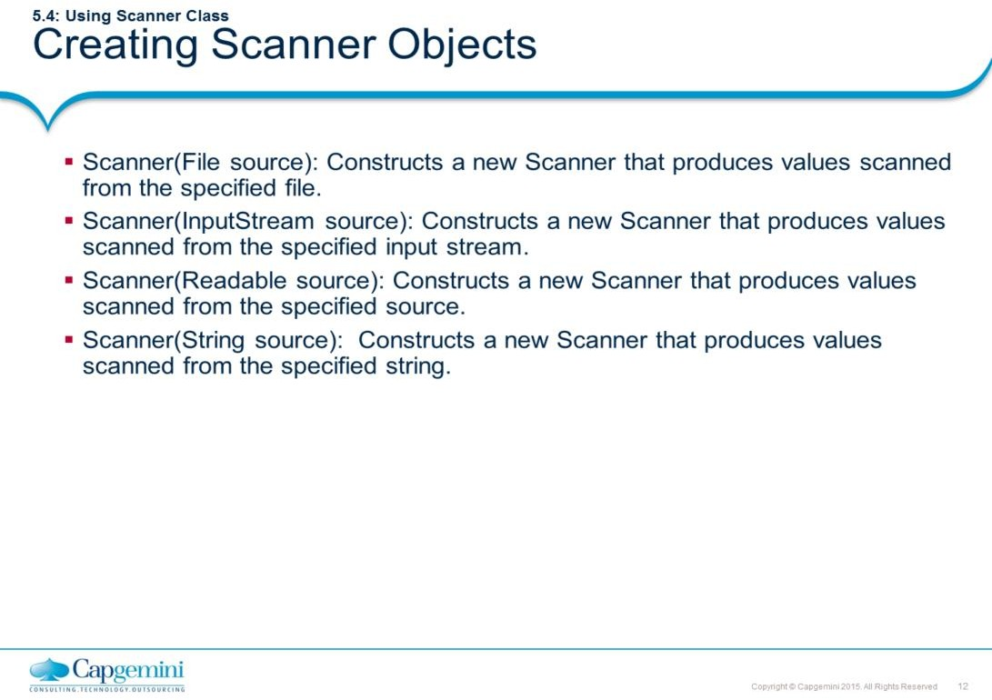
Core Java 8 and Development Tools
Exploring Basic Java Class Libraries

Slide 13
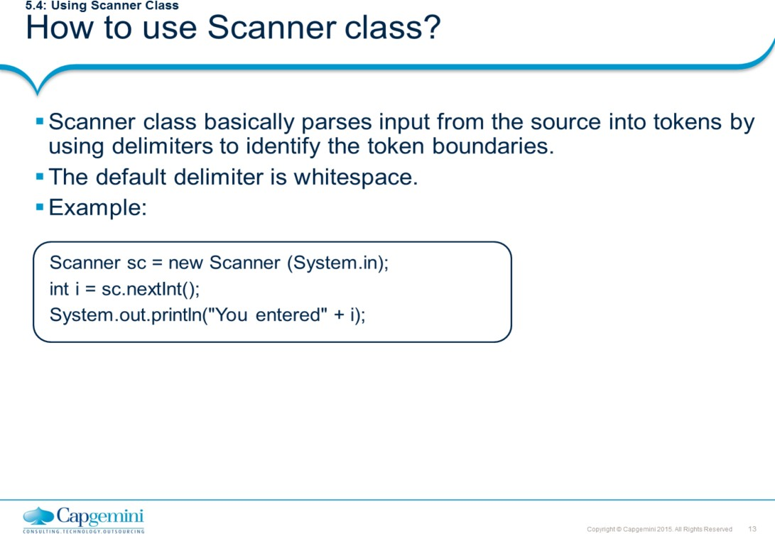
Core Java 8 and Development Tools
Exploring Basic Java Class Libraries
Example 1:
import java.util.Scanner;
public class ParseString
{
public static void main(String[] args)
{
private static Scanner scanner = new
Scanner("1 2 3 4 5 6 7 8");
while (scanner.hasNextInt()) {
int num = scanner.nextInt();
if (num % 2 == 0) System.out.print(num);
}
}
}
Output: 2
4
6
8

Slide 14
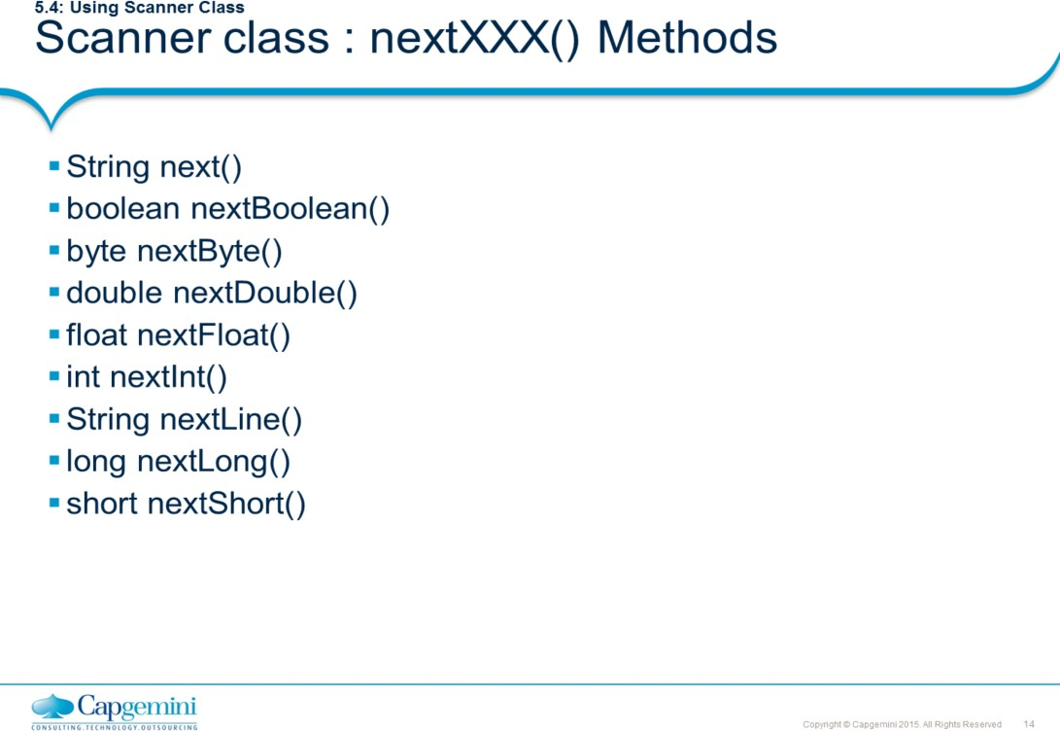
Core Java 8 and Development Tools
Exploring Basic Java Class Libraries
String next(): Finds and returns the next complete token from this scanner. boolean nextBoolean(): Scans the next token of the input into a boolean value and returns that value.
byte nextByte(): Scans the next token of the input as a byte.
double nextDouble(): Scans the next token of the input as a double.
float nextFloat(): Scans the next token of the input as a float.
int nextInt(): Scans the next token of the input as an int.
String nextLine(): Advances this scanner past the current line and returns the input that was skipped.
long nextLong(): Scans the next token of the input as a long. short nextShort(): Scans the next token of the input as a short.
InputMismatchException: This exception can be thrown if you try to get the next token using a next method that does not match the type of the token

Slide 15
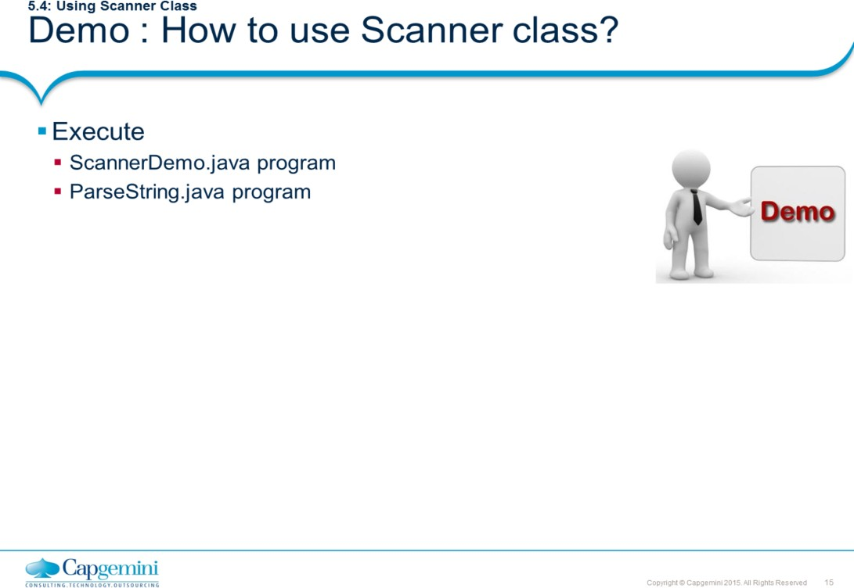
Core Java 8 and Development Tools
Exploring Basic Java Class Libraries
When you create an instance of the Scanner class, the default delimiter is whitespace. The Scanner class provides the useDelimiter method for specifying the Delimiter.
import java.util.Scanner; public class ParseString
{
public static void main(String[] args)
{
Scanner scanner = new Scanner("1, 2, 3, 4, 5, 6, 7,8").useDelimiter(", ");
while (scanner.hasNextInt()) { int num = scanner.nextInt();
if (num % 2 == 0) System.out.println(num);
}
}
}

Slide 16
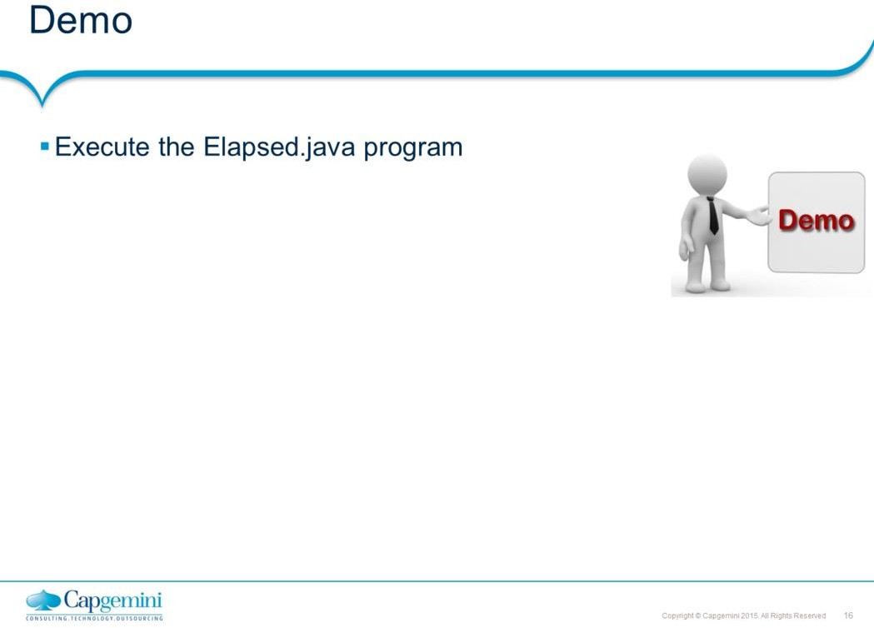
Core Java 8 and Development Tools
Exploring Basic Java Class Libraries
class Elapsed {
public static void main(String args[]) throws IOException { long start, end;
int i = 0, sum = 0; String str = null;
System.out.println("Timing a for loop from 0 to 1,000,000");
// time a for loop from 0 to 1,000,000
start = System.currentTimeMillis(); // get starting time for(int j=0; j < 1000000; j++) ;
end = System.currentTimeMillis(); // get ending time System.out.println("Elapsed time: " + (end-start));
// Demo to read from the system input and write to standard output. BufferedReader br = new
BufferedReader(new InputStreamReader(System.in));
do {
System.out.println("Enter 0 to quit"); str = br.readLine();
i = Integer.parseInt(str);
if ( i == 0 ) System.exit(0); // normal exit sum += i;
System.out.println("Current sum is: " + sum);
} while(i != 0);
}}

Slide 17
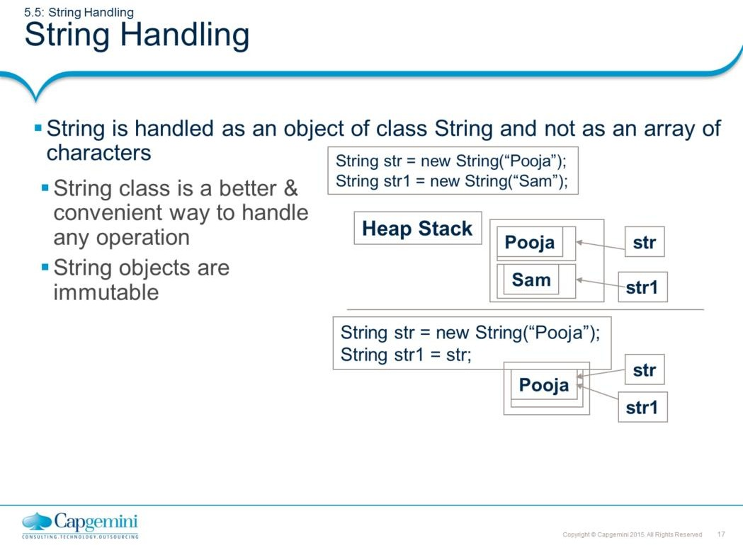
Core Java 8 and Development Tools
Exploring Basic Java Class Libraries
String is not an array of characters but it is actually a class and is part of core API. We can use the class String as a usual data-type. It can store up to 2 billion characters.
Note: A String in java is not equivalent to character array.
Strings are built-in objects & thus have a full complement of features that make string handling convenient. For example, Java has methods to compare two strings, search for a sub string, concatenate two strings etc. In addition, String objects can be constructed in number of ways.
String objects are immutable objects. That is, once you create a String object you cannot change the characters, which are part of String. This seems to be a major restriction, but that is not the case. Every time you perform some modification operation on the object, a new String object is created that contains the modifications. The original string is left unchanged. Hence, the number of operations performed on one particular string creates those many string objects.
For those cases in which modifiable string is desired, there is a companion class to String called StringBuffer, whose objects contain strings that can be modified after they are created.

Slide 18
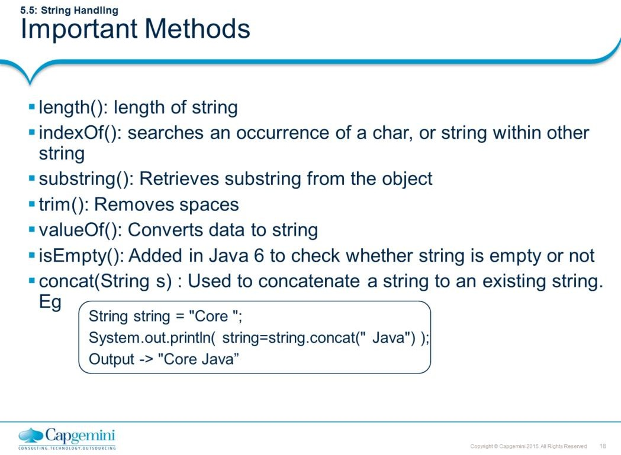
Core Java 8 and Development Tools
Exploring Basic Java Class Libraries
String.isEmpty() method added in Java 6 to check whether the given string is empty or not. Code prior to JDK 6 is as shown below:
//code prior to JDK 6
public boolean checkStringForEmpty(String str) {
If(str.equals(“”)) { return true;
else
return false;
//str.length==0
}
//now with JDK 6 enhancement
public boolean checkStringForEmpty(String str) {
If(str.isEmpty()) { return true;
else
return false;
//much faster than the previous code
}

Slide 19
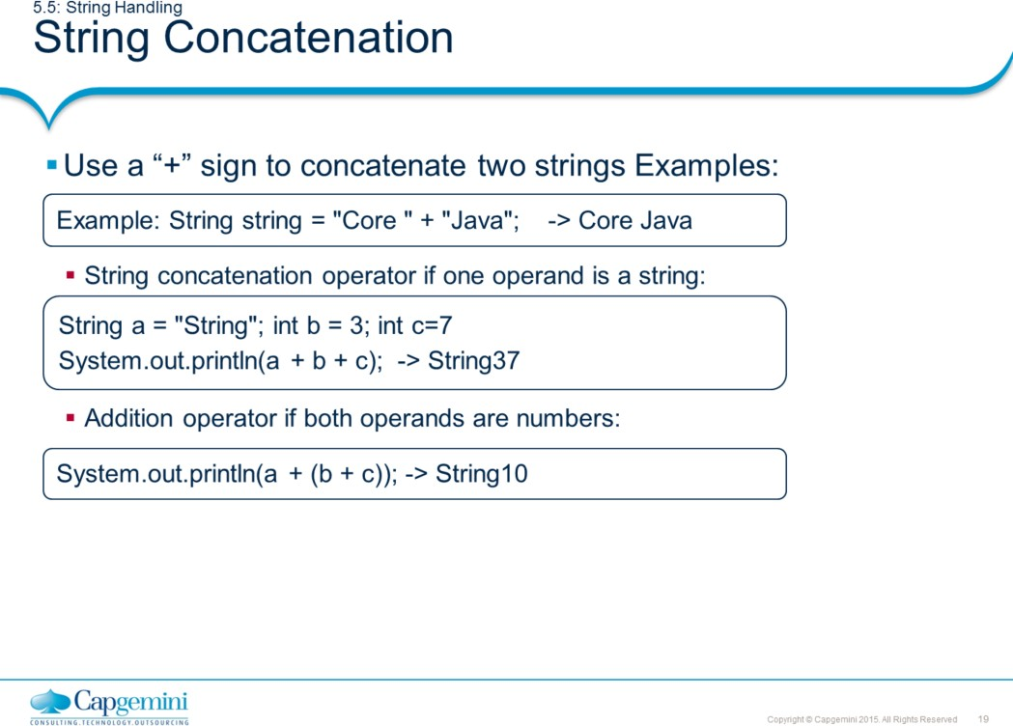
Core Java 8 and Development Tools
Exploring Basic Java Class Libraries
The concat() method seen in previous page allows one string to be concatenated to another. But Java also supports string concatenation with the “+” operator.
In general, Java does not support operator overloading. The exception to this rule is the
+ operator, which concatenates two strings, and produces a new string object as a result.
class SimpleString {
public static void main(String args[]) {
// Simple String Operations char c[] = {'J', 'a', 'v', 'a'};
String s1 = new String(c); // String constructor using String s2 = new String(s1);
// String constructor using string as arg. System.out.println(s1); System.out.println(s2);
System.out.println("Length of String s2 : " + s2.length()); System.out.println("Index of v : " + s2.indexOf('v')); System.out.println("s2 in uppercase : " + s2.toUpperCase()); System.out.println("Character at position 2 is : " + s2.charAt(1));
// Using concatenation to prevent long lines.
String longStr = "This could have been " +
"a very long line that would have " +
"wrapped around. But string concatenation " + "prevents this.";
System.out.println(longStr);
} }

Slide 20
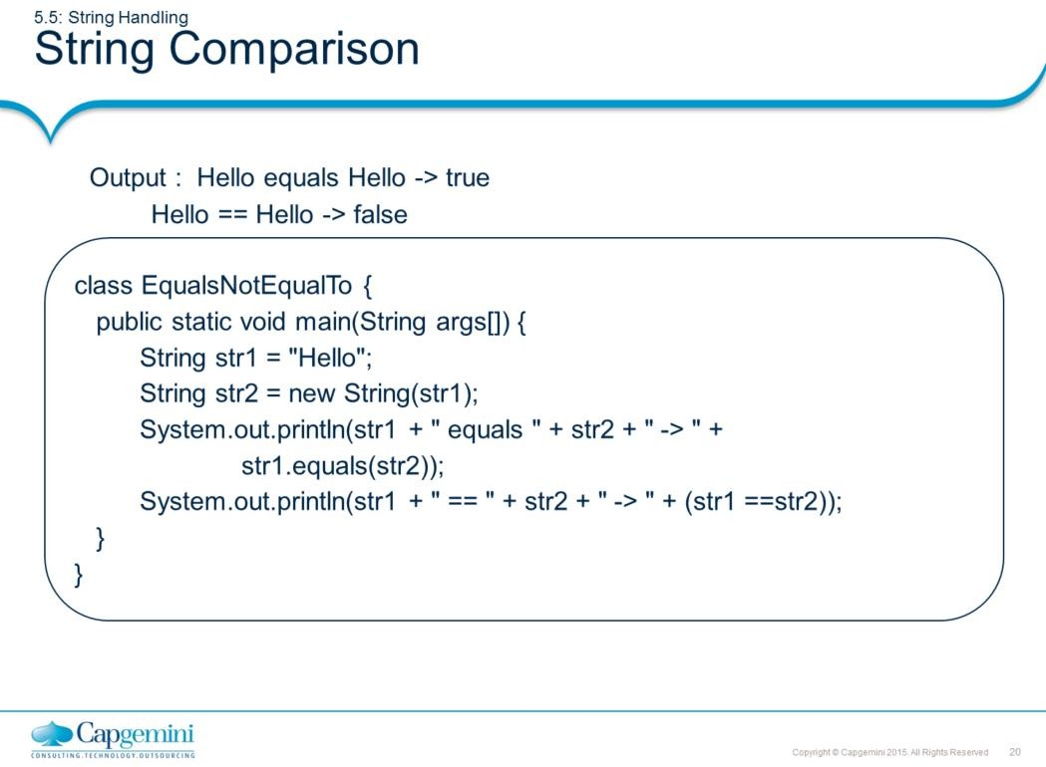
Core Java 8 and Development Tools
Exploring Basic Java Class Libraries
The String class includes various methods that compare strings or substrings within each string. The most popularly used two ways to compare the strings is either using = = operator or by using the equals method.
The equals() method compares the characters inside a String object. The = = operator compare two object references to see whether they refer to the same instance. The program above shows the difference between the two.

Slide 21
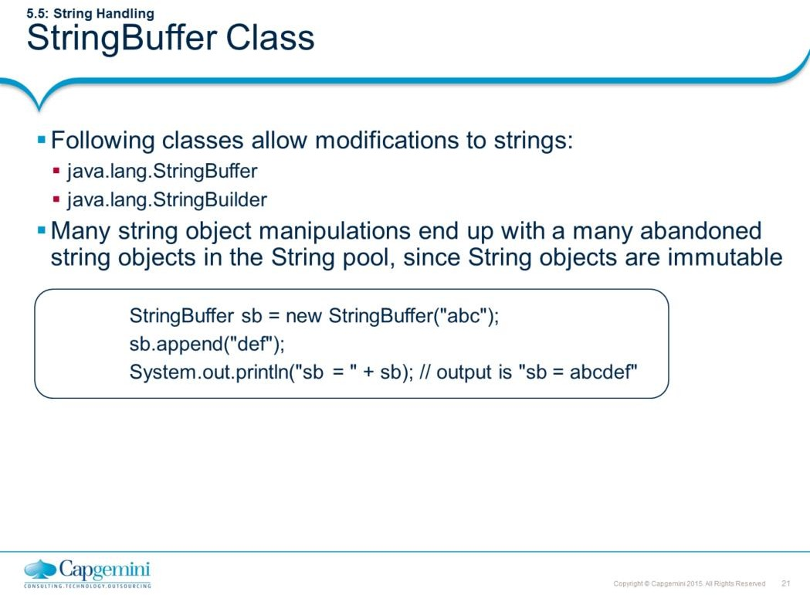
Core Java 8 and Development Tools
Exploring Basic Java Class Libraries
Let us understand StringBuilder with an example.
String x = "abc"; x.concat("def");
System.out.println("x = " + x); // output is "x = abc"
Because no new assignment was made, the new String object created with the concat() method was abandoned instantly. We also saw examples like this:
String x = "abc";
x = x.concat("def");
System.out.println("x = " + x); // output is "x = abcdef"
We got a nice new String out of the deal, but the downside is that the old String "abc" has been lost in the String pool, thus wasting memory. If we were using a StringBuffer instead of a String, the code would look like this:
StringBuffer sb = new StringBuffer("abc"); sb.append("def");
System.out.println("sb = " + sb); // output is "sb = abcdef“
Note: Refer Javadocs to know more about other methods of StringBuilder.

Slide 22
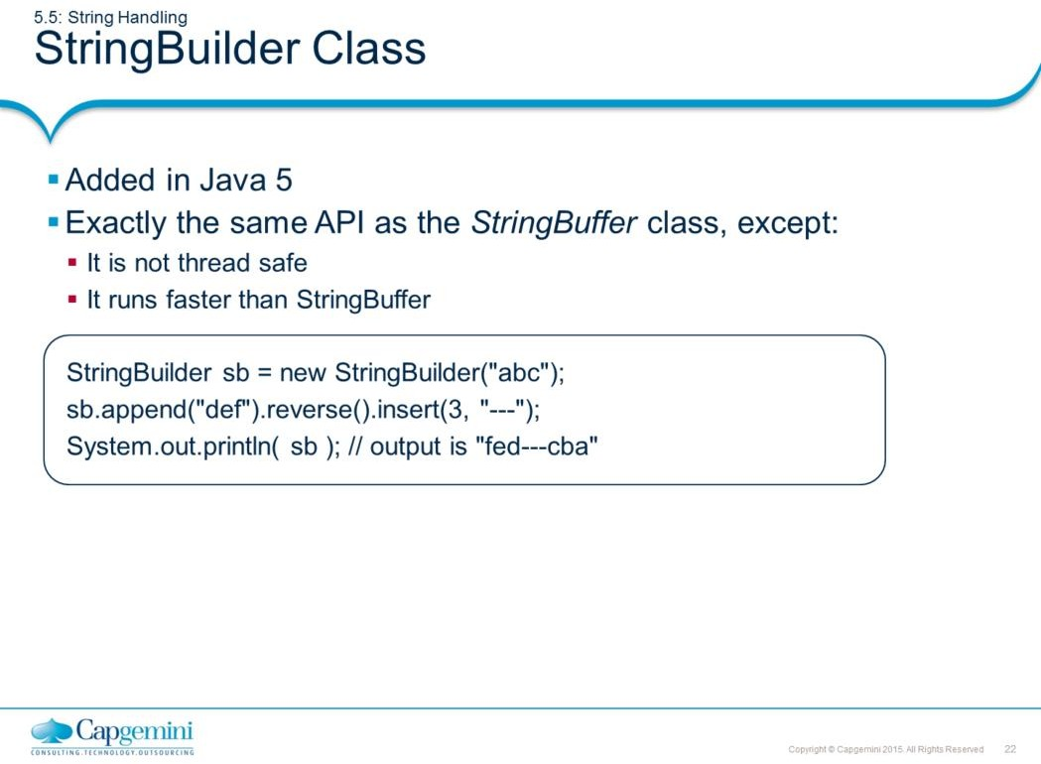
Core Java 8 and Development Tools
Exploring Basic Java Class Libraries
The StringBuilder class was added in Java 5. It has exactly the same API as the StringBuffer class, except StringBuilder is not thread safe. In other words, its methods are not synchronized. Sun recommends that you use StringBuilder instead of StringBuffer whenever possible because StringBuilder will run faster (and perhaps jump higher). So, apart from
Synchronization, anything we say about StringBuilder's methods holds true for
StringBuffer's methods, and vice versa.
Note: Refer Javadocs to know more about methods of StringBuilder.

Slide 23
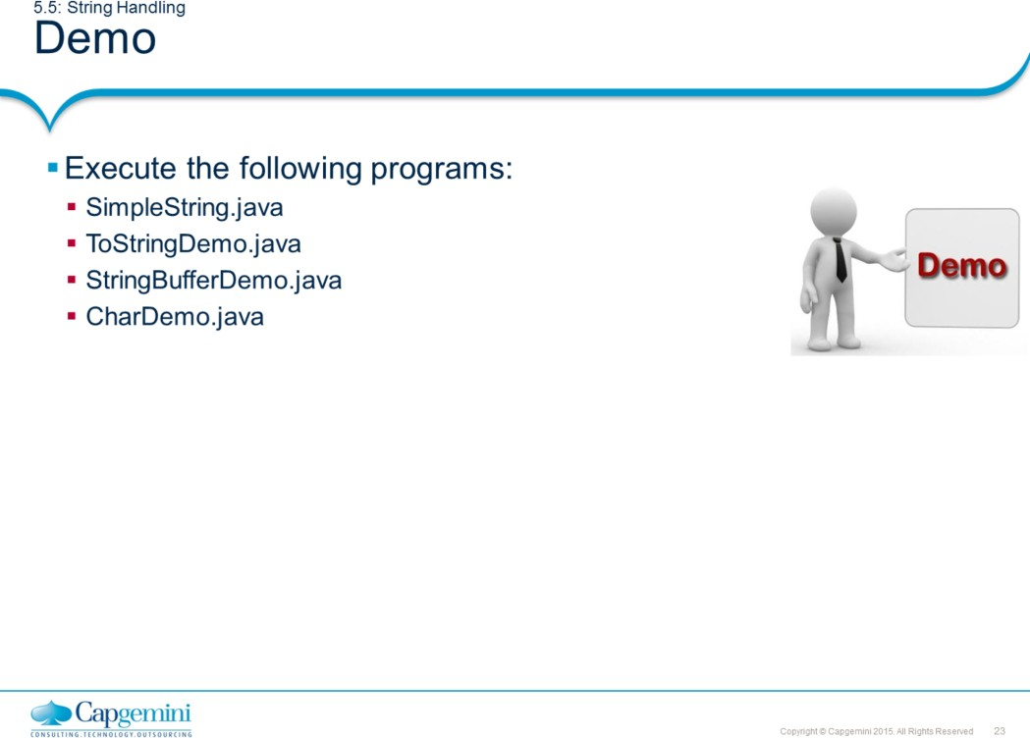
Core Java 8 and Development Tools
Exploring Basic Java Class Libraries

Slide 24
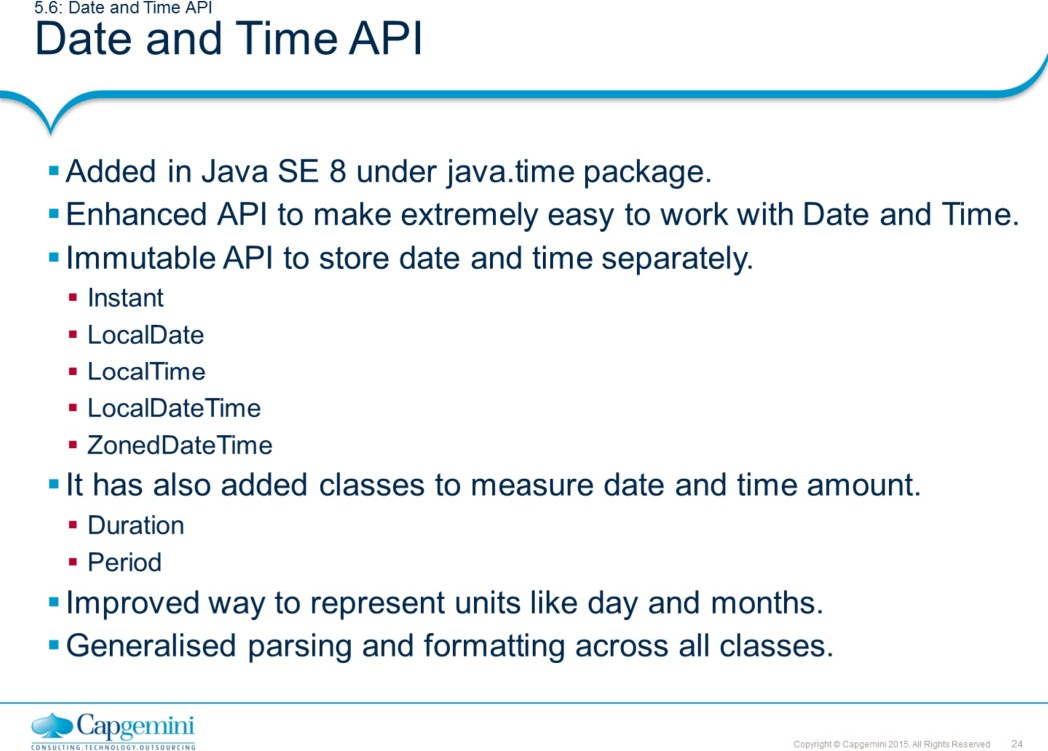
Core Java 8 and Development Tools
Exploring Basic Java Class Libraries
A long-standing bugbear of Java developers has been the inadequate support for the date and time. In order to address problems in legacy API (Date and Calender) and provide better support in the JDK core, a new date and time API (JSR 310 ) has been designed for Java SE 8 under java.time package.
LocalDate and LocalTime represents date and time respectively. The combination of date and time is represented by LocalDateTime. If a time zone is important, ZonedDateTime class is handy.
Many times developers need to measure amount of time between to date instants. Duration class used to measure amount of time including nanosecond precision. Period class is used to measure in terms of days, months or years.
This API has included two Enums DayOfWeek and Month to represent day and month constant respectively.
DateTimeFormatter class is used to format the date and times. Also almost all classes
now include parse and format method to support parsing and formatting of date and time.

Slide 25
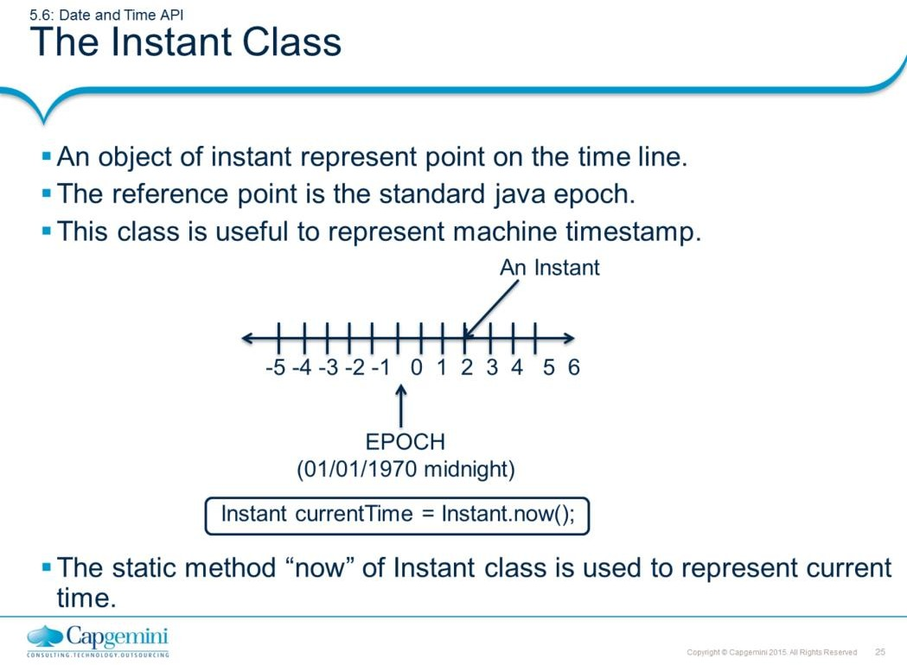
Core Java 8 and Development Tools
Exploring Basic Java Class Libraries
Instant class is useful for generating a time stamp to represent machine time. A value returned from the Instant class counts time beginning from the first second of January 1, 1970. This value is known as EPOCH.
An epoch is an instant on a timeline that is used as a reference point (or the origin) to measure other instants. As shown in the above figure, an Instant at epoch is represent by zero. Instants after epoch are positive numbers where as instants before epoch are negative.

Slide 26
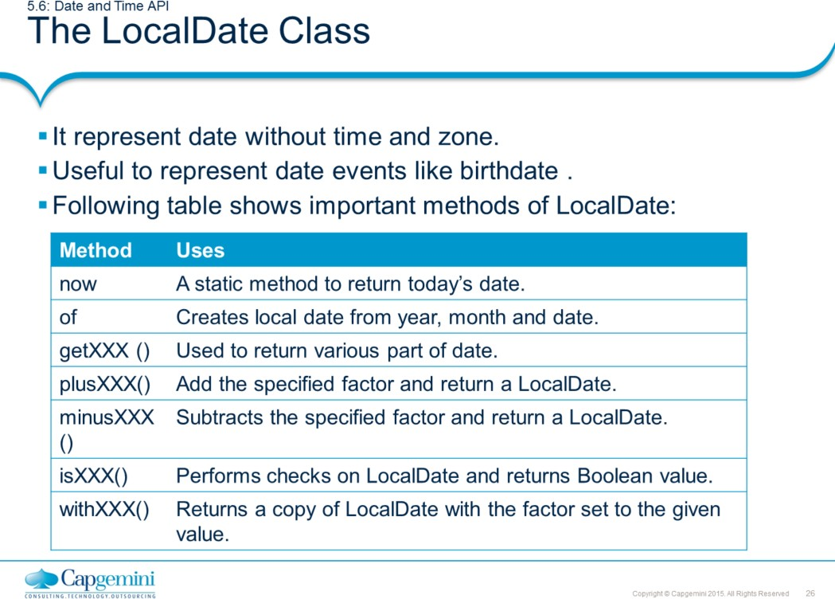
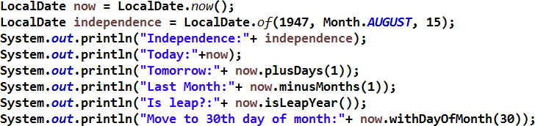
Core Java 8 and Development Tools
Exploring Basic Java Class Libraries
A LocalDate represents a year-month-day in the ISO calendar and is useful for representing a date without a time.
The other two classes LocalTime and LocalDateTime as name reflects are used to store time and date with time respectively.
Most of the methods of LocalDateTime are analogous to LocalDate with few additional
methods like plusHours(), plusMinutes() etc.

Slide 27
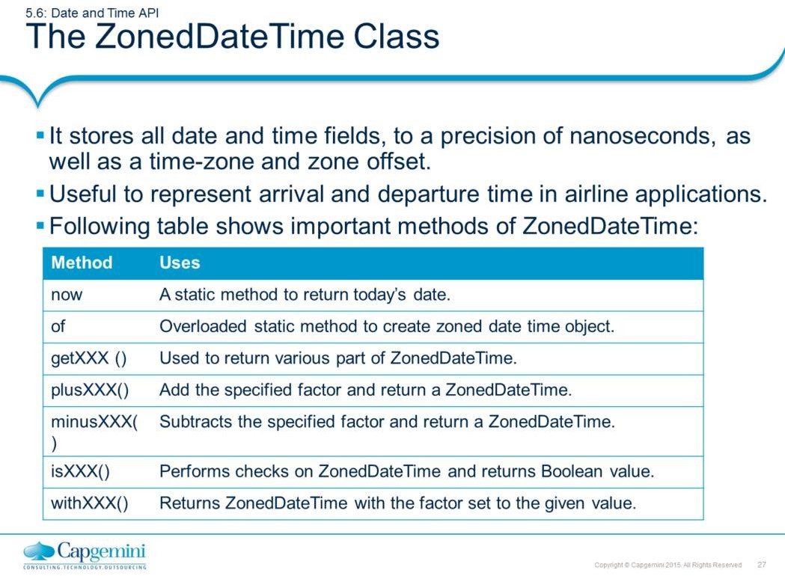

Core Java 8 and Development Tools
Exploring Basic Java Class Libraries
A ZonedDateTime represents a point in time in a given time zone
that can be converted to an instant on the timeline; it is aware of Daylight Saving Time.

Slide 28
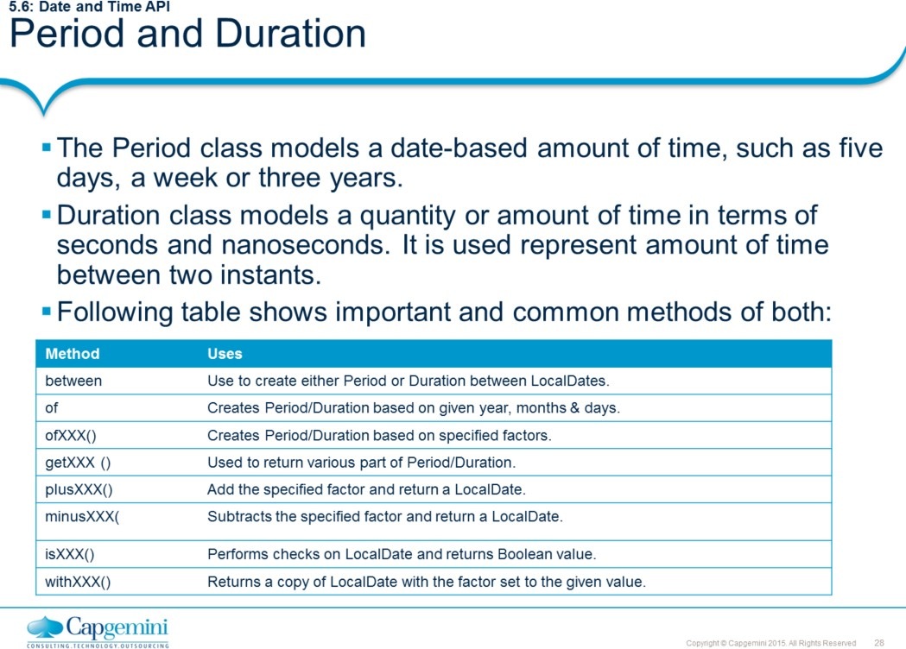
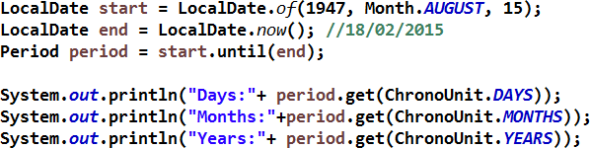
Core Java 8 and Development Tools
Exploring Basic Java Class Libraries
The following example shows how to find period between two dates.

Slide 29
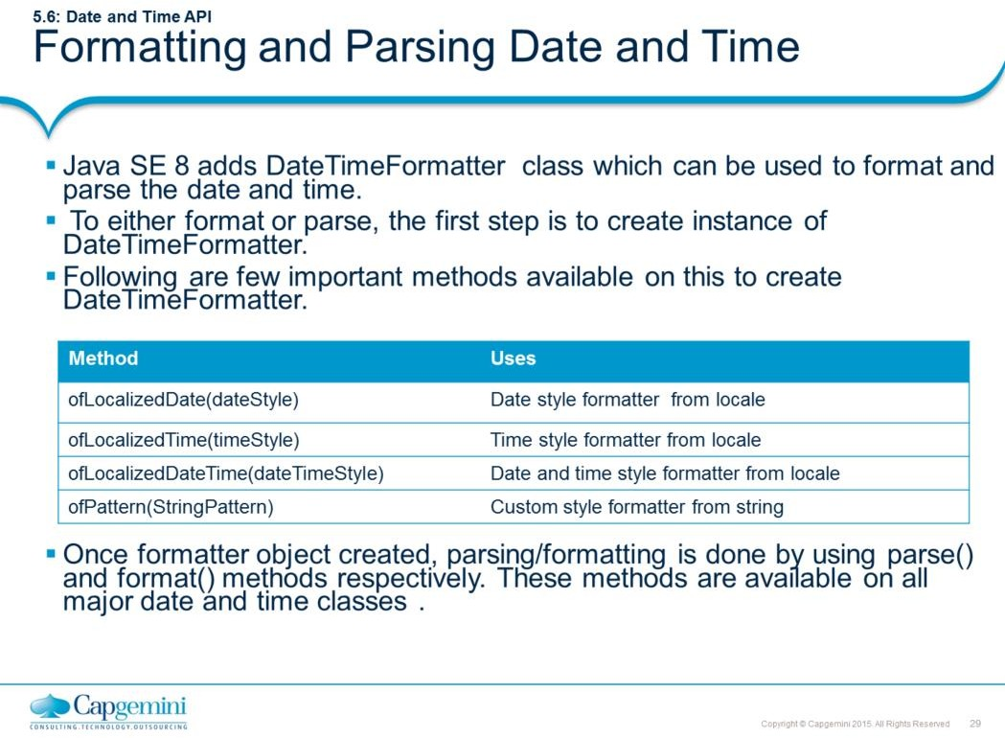

Core Java 8 and Development Tools
Exploring Basic Java Class Libraries
To format or parse a date/time, first we need to create instance of DateTimeFormatter. Following example shows, how to format a date using this class. The below example shows how to format the LocalDate in medium style.
The following example shows how to parse a text string into date.

Slide 30
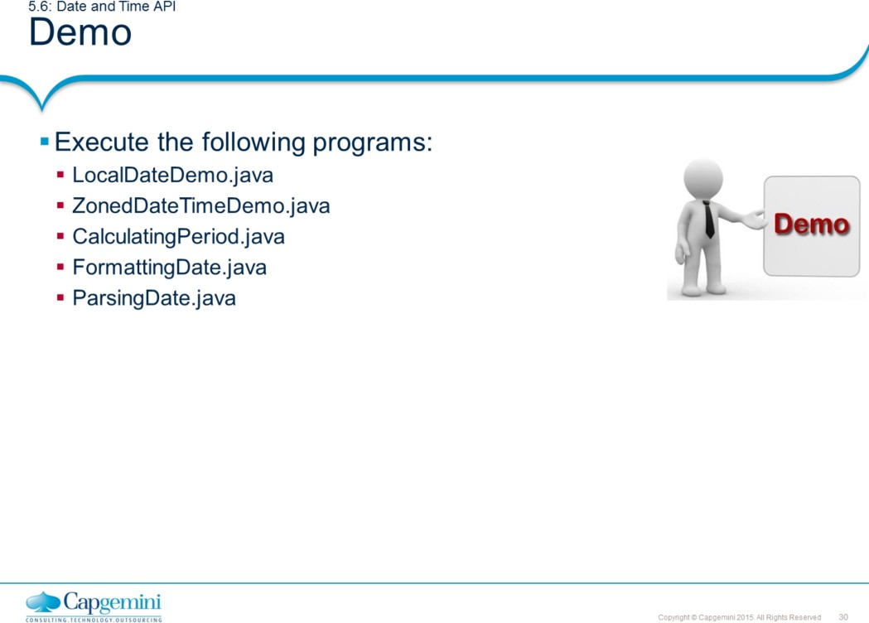
Core Java 8 and Development Tools
Exploring Basic Java Class Libraries

Slide 31
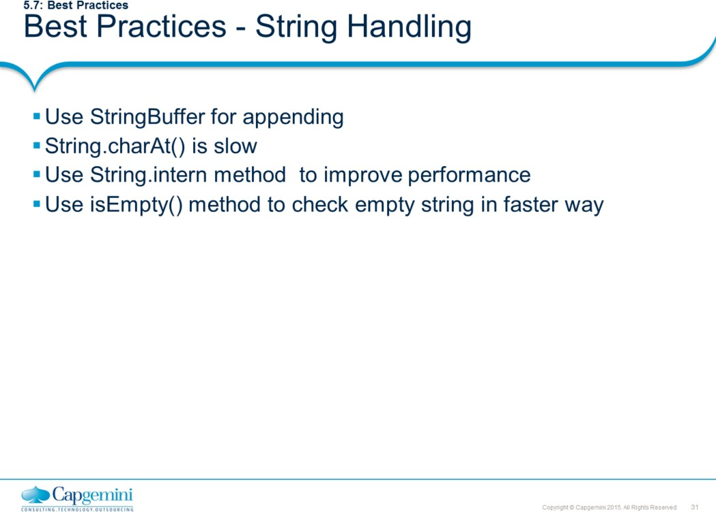
Core Java 8 and Development Tools
Exploring Basic Java Class Libraries
Use StringBuffer for appending
Always use StringBuffer for appending. Appending by StringBuffer is almost 200 times faster than by using String.concat and "+" operator. But if String constants are to be appended "+" is faster than StringBuffer.append because it is resolved in compile time. Any code with constants is faster.
String.charAt() is slow
The method charAt(int index) returns an individual char from inside a string (see also the substring() method below). The valid index numbers are in the range 0..length-1. Using an index number outside of that range will raise a runtime exception and stop the program at that point.
String string = "hello"; char a = string.charAt(0); // a is 'h' char b = string.charAt(4); // b is 'o‘
char c = string.charAt(string.length() - 1); // same as above line char d = string.charAt(99); // ERROR, index out of bounds
charAt() is slow because it does check for bounds before finding the character. Secondly, it is not declared as final which actually make a bit slower. One can use indexOf and a loop. Which is at least 3 times faster than charAt().

Slide 32
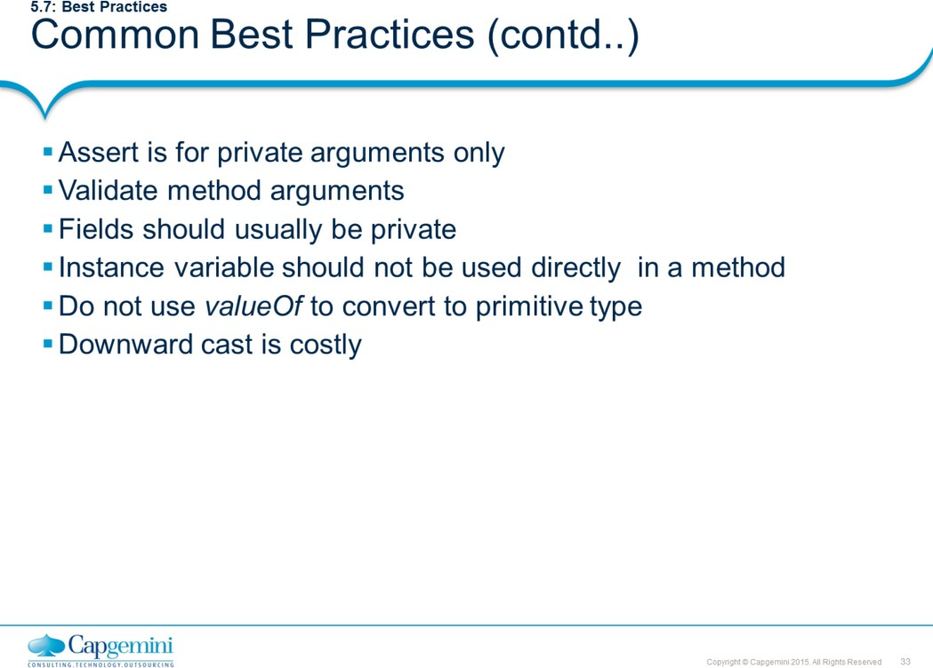
Core Java 8 and Development Tools
Exploring Basic Java Class Libraries
Assert is for private arguments only
Most validity checks in a program are checks on parameters passed to non-private methods. The assert keyword is not meant for these types of validations.
Assertions can be disabled. Since checks on parameters to non-private methods implement the requirements demanded of the caller, turning off such checks at runtime would mean that part of the contract is no longer being enforced.
Conversely, checks on arguments to private methods can indeed use assert. These checks are made to verify assumptions about internal implementation details, and not to check that the caller has followed the requirements of a non-private method's contract.
Validate method arguments
The first lines of a method are usually devoted to checking the validity of method arguments. The idea is to fail as quickly as possible in the event of an error. This is particularly important for constructors. It is a reasonable policy for a class to skip validating arguments of private methods. The reason is that private methods can only be called from the class itself. Thus, a class author should be able to confirm that all calls of a private method are valid. If desired, the assert keyword can be used to check private method arguments, to check the internal consistency of the class.
Page 05-33

Slide 33
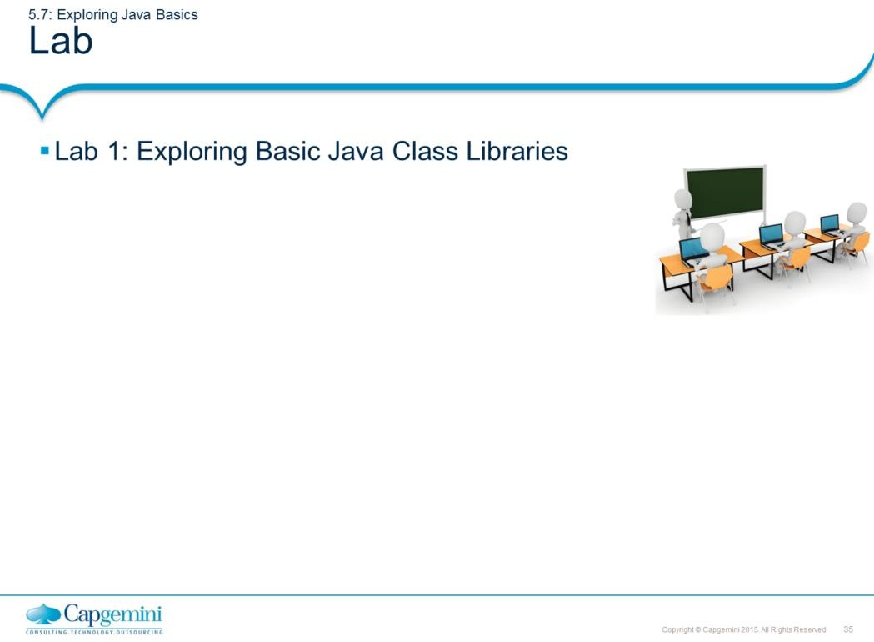
Core Java 8 and Development Tools
Exploring Basic Java Class Libraries

Slide 34
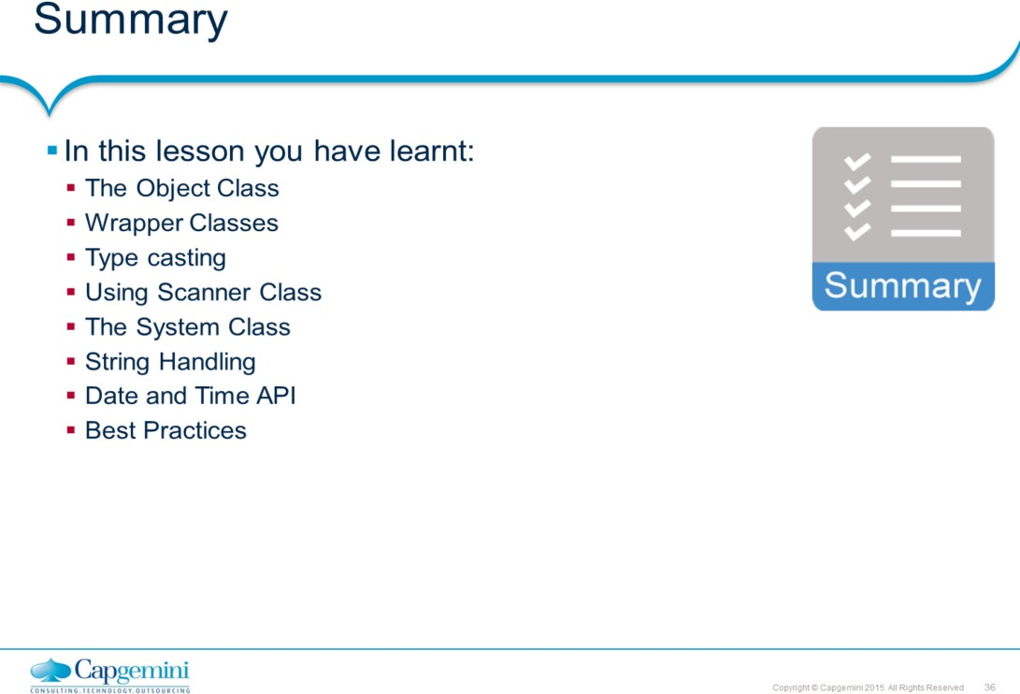
Core Java 8 and Development Tools
Exploring Basic Java Class Libraries
Add the notes here.

Slide 35
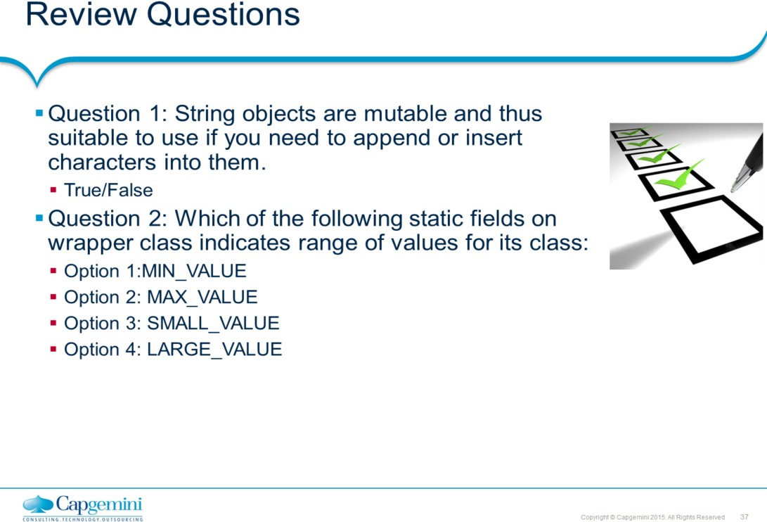
Core Java 8 and Development Tools
Exploring Basic Java Class Libraries

